Slide 1
Entropy and the Ideal Gas
Thomas Conibear
PHYS 300

Slide 2
Introduction
Ideal gas
Entropy of two different gases mixing
Simulating an ideal gas mixing and finding entropy
Comparison between prediction and simulation

Slide 3
Theory
Theory of an ideal gas:
All particles identical
All collisions are elastic
Volume of particles are negligible
Collisions between the particle and container walls are only considered

Slide 4
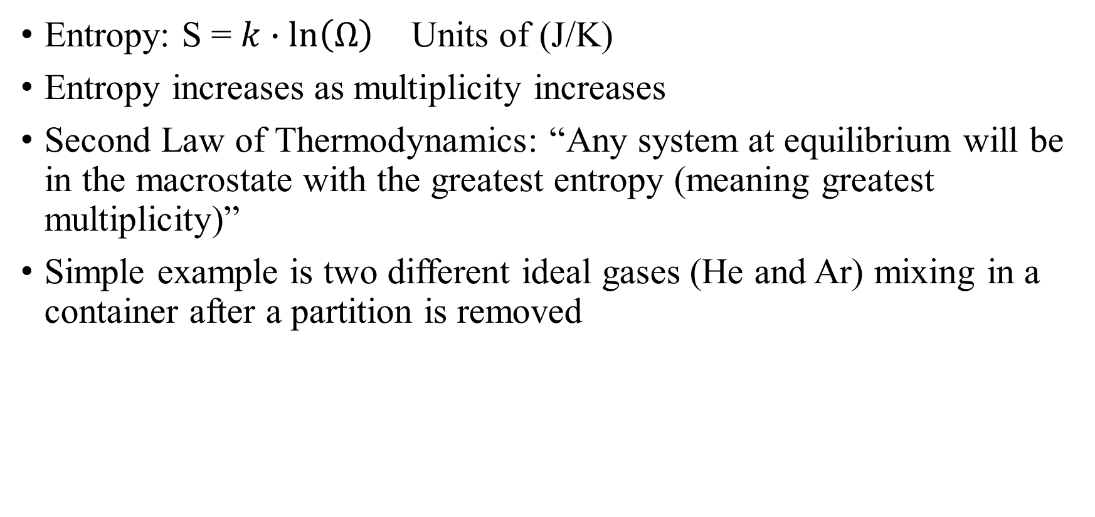
Theory
Entropy: S = $k∙\ln\left(Ω\right)$ Units of (J/K)
Entropy increases as multiplicity increases
Second Law of Thermodynamics: “Any system at equilibrium will be in the macrostate with the greatest entropy (meaning greatest multiplicity)”
Simple example is two different ideal gases (He and Ar) mixing in a container after a partition is removed

Slide 5

Python Implementation
Sackur-Tetrode equation is used to get entropy of system prior to mixing
$S=Nk\left[\ln\left(\frac{V}{N}{\left(\frac{4πmU}{3Nh^{2}}\right)}^{3/2}\right)+\frac{5}{2}\right]$

Slide 6
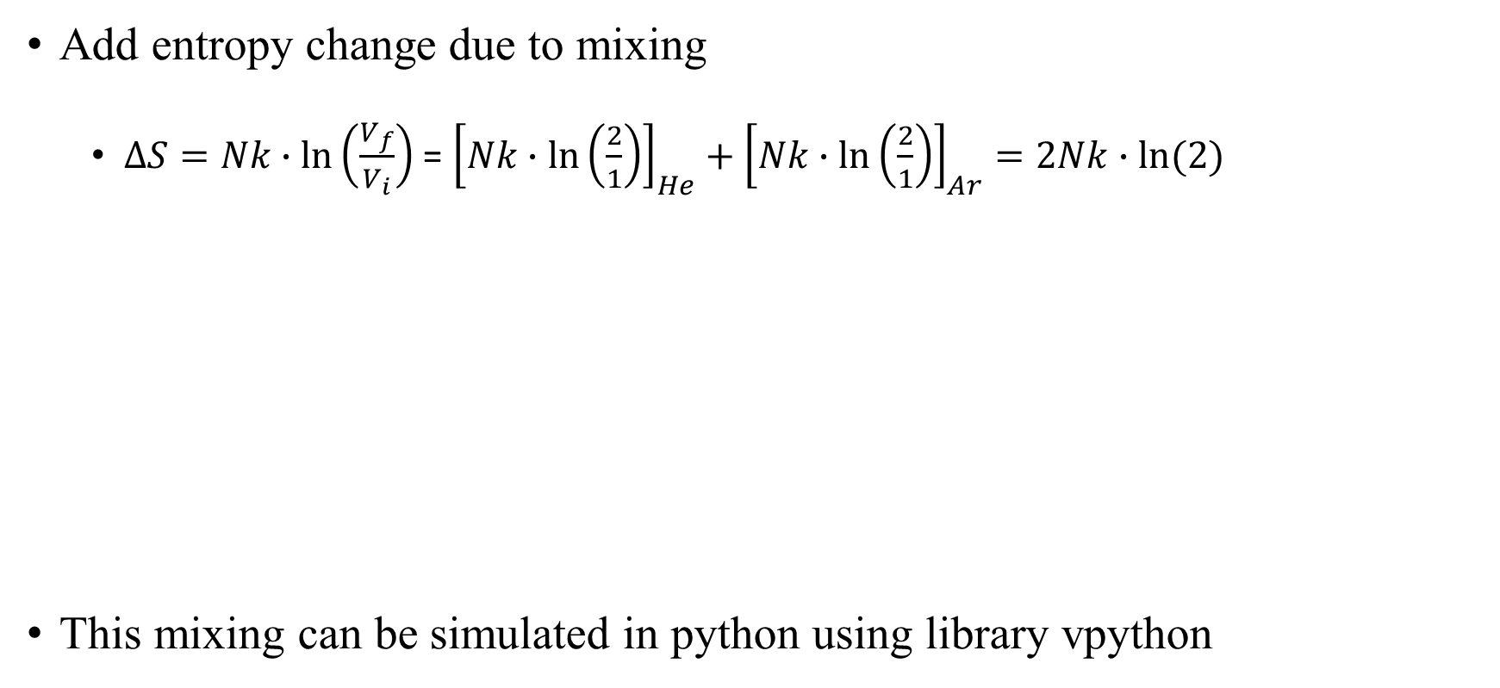
Python Implementation
Add entropy change due to mixing
$∆S=Nk∙\ln\left(\frac{V_{f}}{V_{i}}\right)$ = ${\left[Nk∙\ln\left(\frac{2}{1}\right)\right]}_{He}+{\left[Nk∙\ln\left(\frac{2}{1}\right)\right]}_{Ar}=2Nk∙ln(2)$
This mixing can be simulated in python using library vpython

Slide 7
vpython Simulation
1. Generates random particle positions
2. Assigns red or blue based on x location to origin which is the divider

Slide 8
vpython Simulation
3. Kinetic energy equals average energy (equipartition theorem)
4. Randomizes initial momentum vector components of each particle
5. Continually updates all positions until collision with wall/divider

Slide 9
vpython Simulation
6. Collision is detected by the particle’s position exceeding the length of the container’s side in the respective x, y, or z coordinate.
7. When a detection is triggered, that specific momentum component is reversed.

Slide 10
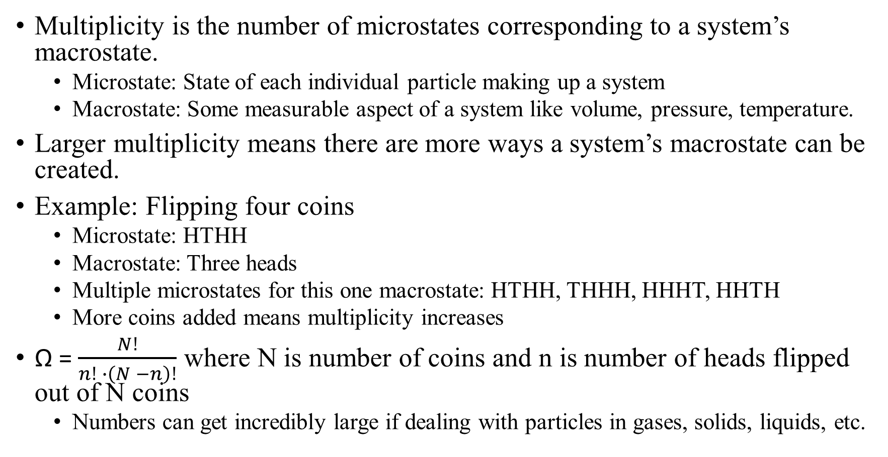
Multiplicity Explained
Multiplicity is the number of microstates corresponding to a system’s macrostate.
Microstate: State of each individual particle making up a system
Macrostate: Some measurable aspect of a system like volume, pressure, temperature.
Larger multiplicity means there are more ways a system’s macrostate can be created.
Example: Flipping four coins
Microstate: HTHH
Macrostate: Three heads
Multiple microstates for this one macrostate: HTHH, THHH, HHHT, HHTH
More coins added means multiplicity increases
Ω = $\frac{N!}{n! ∙\left(N −n\right)!}$ where N is number of coins and n is number of heads flipped out of N coins
Numbers can get incredibly large if dealing with particles in gases, solids, liquids, etc.

